Slide 1
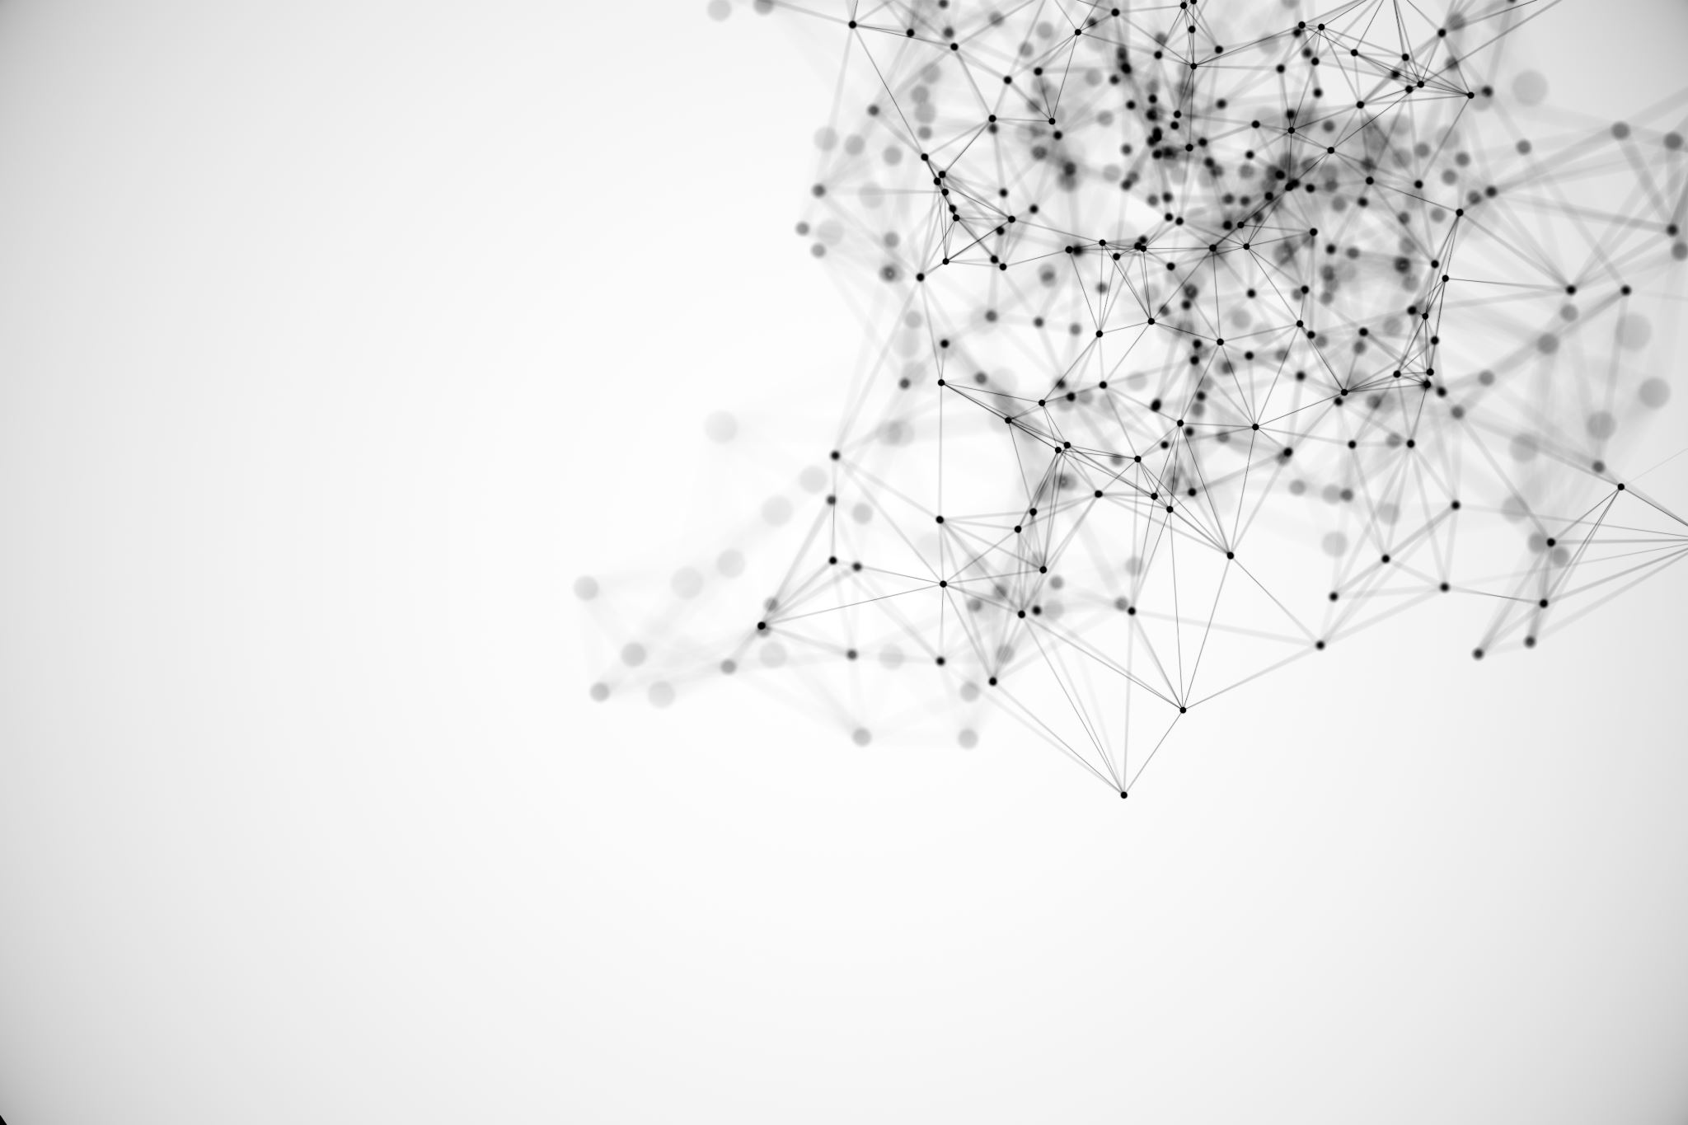
Forebrain Organoids: Biosynthetic Neural Networks
Matthew Lyn – 2024-10-30

Slide 2

About Matt
[Mostly] Educated:
New York U. (Business)
Georgetown (Industrial Sciences)
Jobs:
Disaster Risk Analyst (World Bank)
Healthcare Data Analyst (NeueHealth)
Fun Fact:
Has the same birthday as Bob Marley and Ronald Reagan.

Slide 3
Okay, nice, cool, get back to the brains in jars
Some Context:
(2024-03) AWS buys a $650M Nuclear Plant (960 MegaWatts).
(2024-FQ4) NVIDIA made $60B Rev. this year from its data-center services, 78% was AI-related.
(2023-10) Researchers (UT-Riverside, Arlington) predict “water withdrawal of global AI may reach 4.2 – 6.6 billion cubic meters in 2027”
Notes:
One Gerald R. Ford Class Nuclear Aircraft Carrier is 385 MW * 2, so AWS has 20% more power generation in that one data center.
#3 is a little flawed because it used CPT-3 as the model, GPT-4o is significantly more complex.

Slide 4
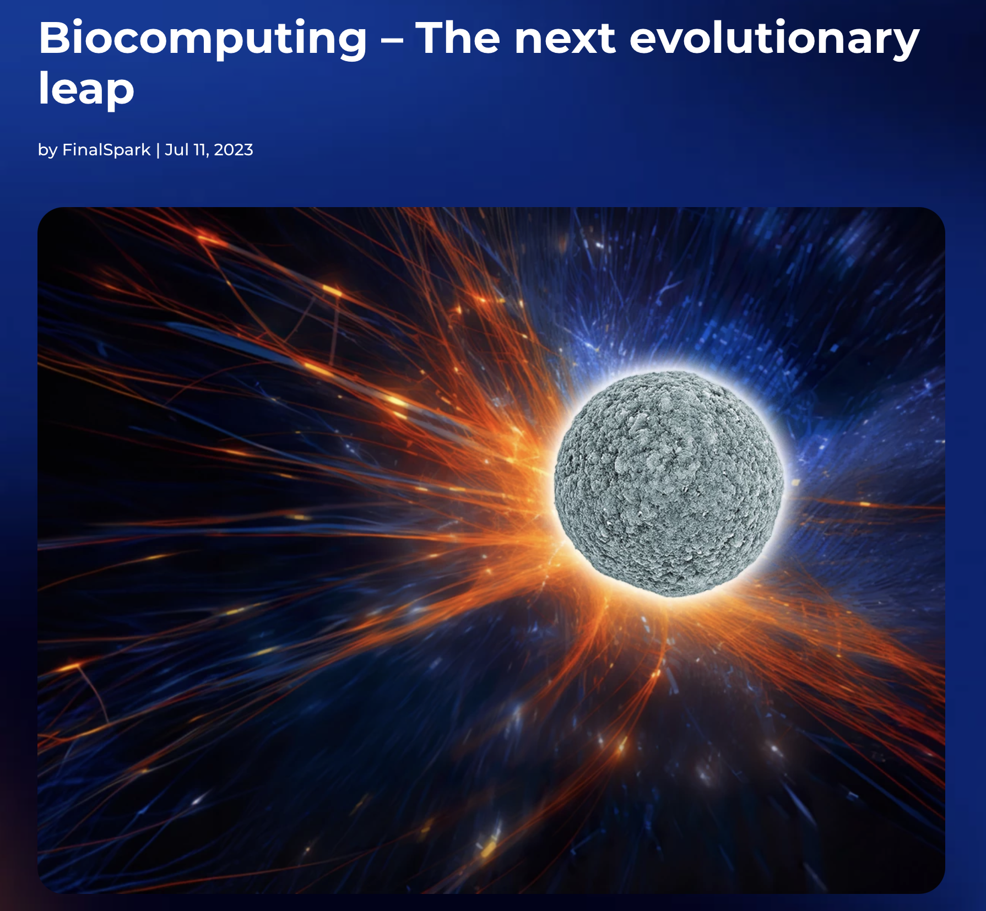
So… Brains?
“We’re creating the solution with biological neural networks.
We’re growing neurons in cell cultures and making great progress in their use as computing power.
…[S]urpassing nature's success with limitless potential for enhancing life on earth.”
FinalSpark. 2023. “Biocomputing - The next Evolutionary Leap.” July 11, 2023.
https://finalspark.com/biocomputing-the-next-evolutionary-leap/.

Slide 5
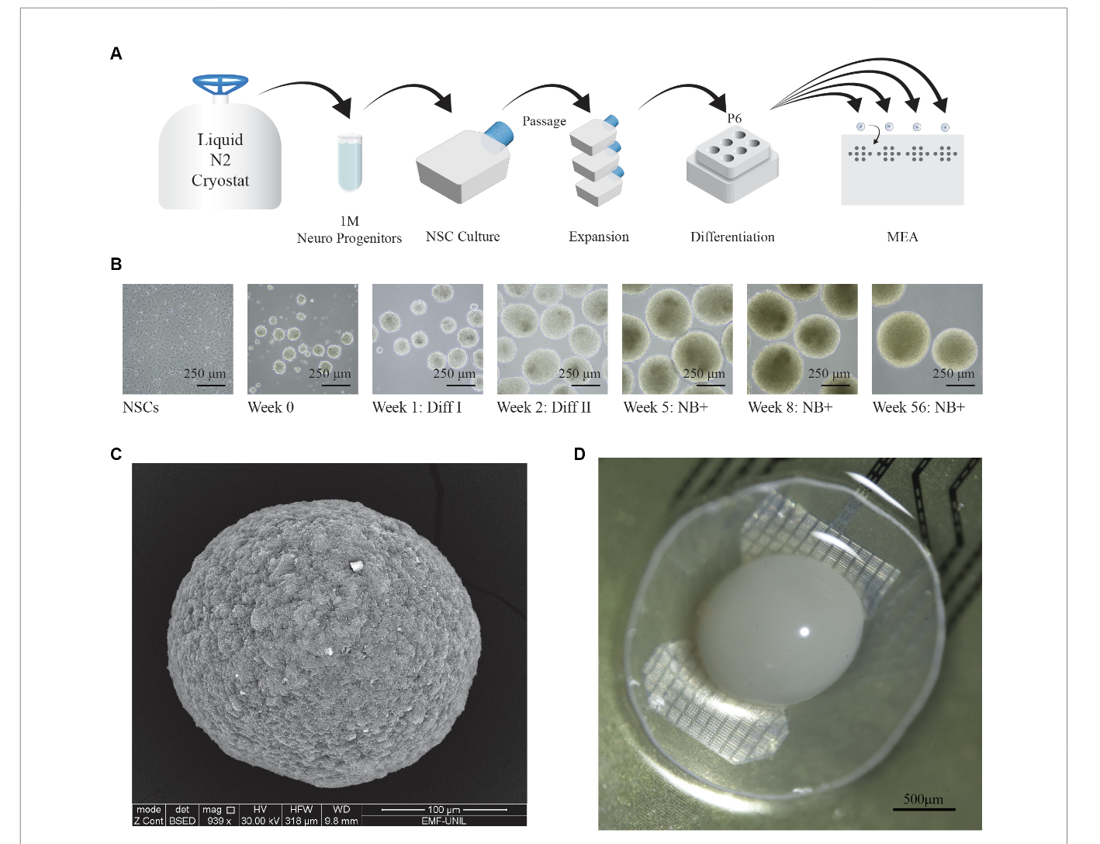
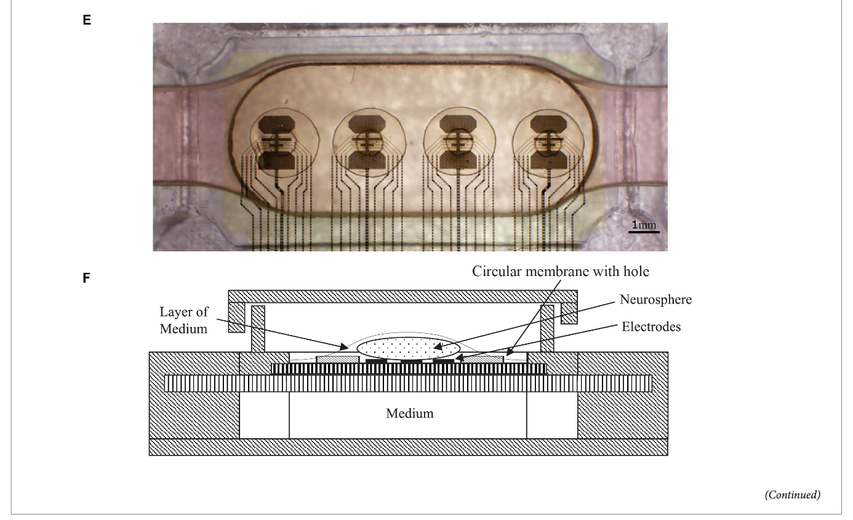
…What?
Jordan, Fred D., Martin Kutter, Jean-Marc Comby, Flora Brozzi, and Ewelina Kurtys. 2024. “Open and Remotely Accessible Neuroplatform for Research in Wetware Computing.” Frontiers in Artificial Intelligence 7 (May). https://doi.org/10.3389/frai.2024.1376042.

Slide 6
How’s the process different?
SILICO-AI
Brain Organoid-AI
1. DATA fed into computer.
2. COMPUTER fires lasers, or electricity into organoid.
3. MACHINE LEARNING MODEL measures neuron activation.
4. TRAINING occurs by iterative release of dopamine into organoid housing after organoid signals the ”optimal” answer.
DATA fed into computer.
COMPUTER fires electricity into silicone wafer.
3. MACHINE LEARNING MODEL computes the “best” response.
4. TRAINING occurs by selection of model which made the “optimal” answer.

Slide 7
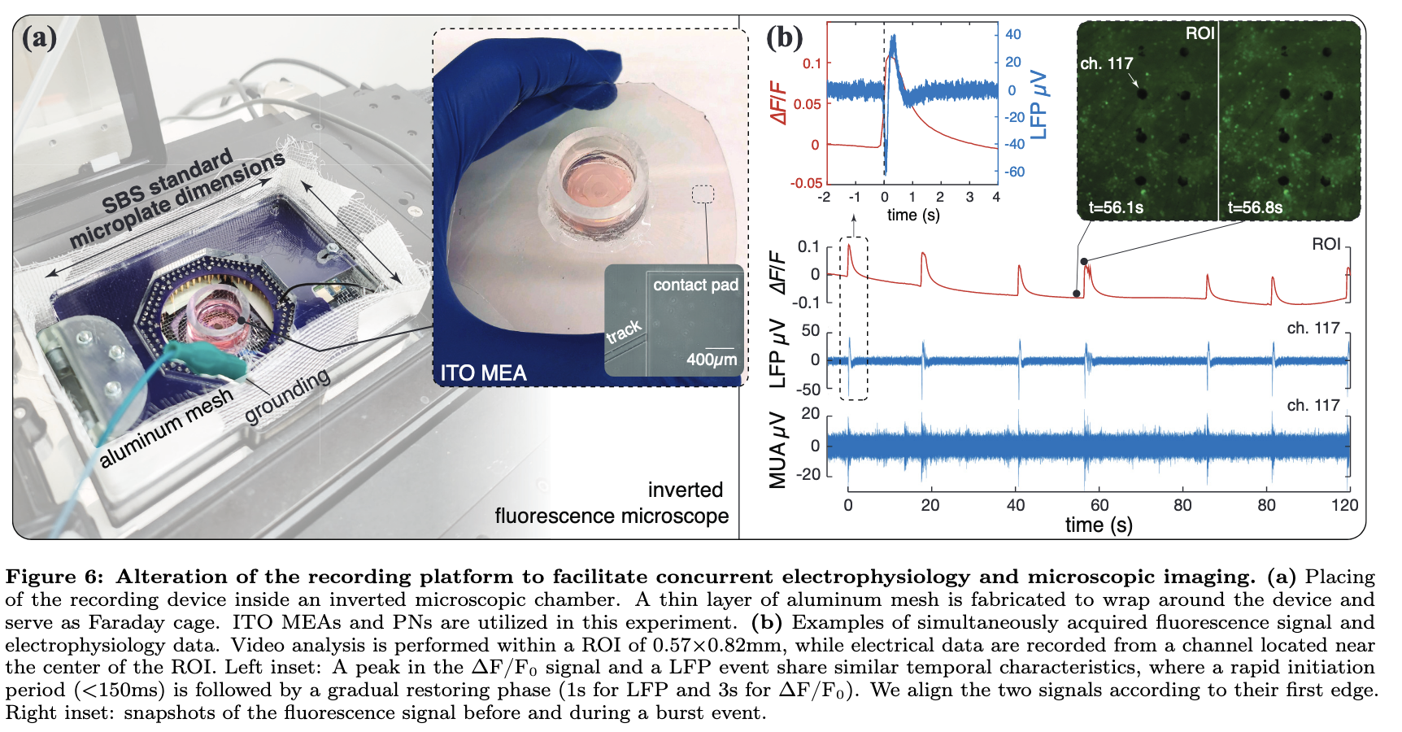
Neuronal Attachment to Micro Electrodes
Zhang, Xiaotian, Zhi Dou, Seung Hyun Kim, Gaurav Upadhyay, Daniel Havert, Sehong Kang, Kimia Kazemi, et al. 2024. “Mind In Vitro Platforms: Versatile, Scalable, Robust, and Open Solutions to Interfacing with Living Neurons.” Advanced Science 11 (11): 2306826. https://doi.org/10.1002/advs.202306826.

Slide 8
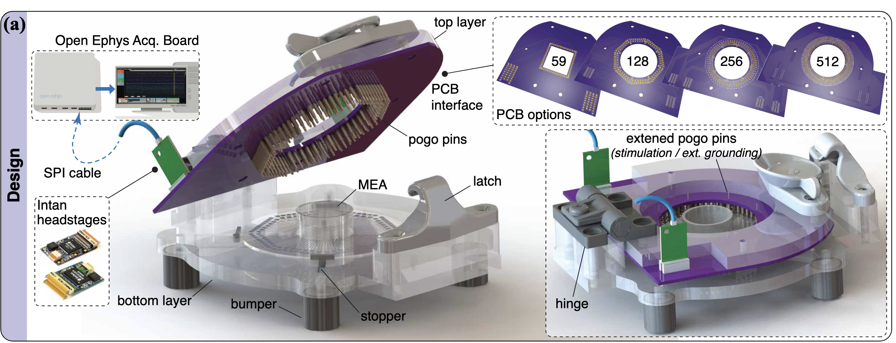
What was the purple bit in the machine?
Zhang, Xiaotian, Zhi Dou, Seung Hyun Kim, Gaurav Upadhyay, Daniel Havert, Sehong Kang, Kimia Kazemi, et al. 2024. “Mind In Vitro Platforms: Versatile, Scalable, Robust, and Open Solutions to Interfacing with Living Neurons.” Advanced Science 11 (11): 2306826. https://doi.org/10.1002/advs.202306826.

Slide 9
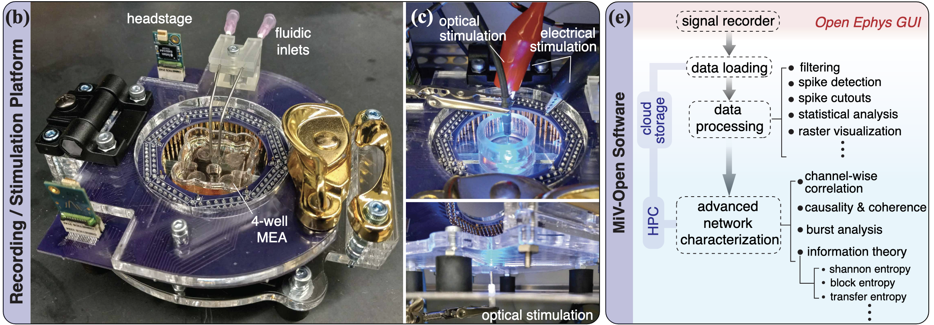
Microfluidics = Vasculature
Zhang, Xiaotian, Zhi Dou, Seung Hyun Kim, Gaurav Upadhyay, Daniel Havert, Sehong Kang, Kimia Kazemi, et al. 2024. “Mind In Vitro Platforms: Versatile, Scalable, Robust, and Open Solutions to Interfacing with Living Neurons.” Advanced Science 11 (11): 2306826. https://doi.org/10.1002/advs.202306826.

Slide 10
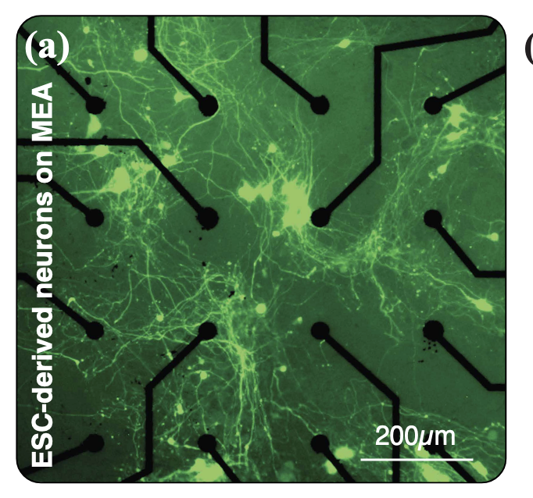
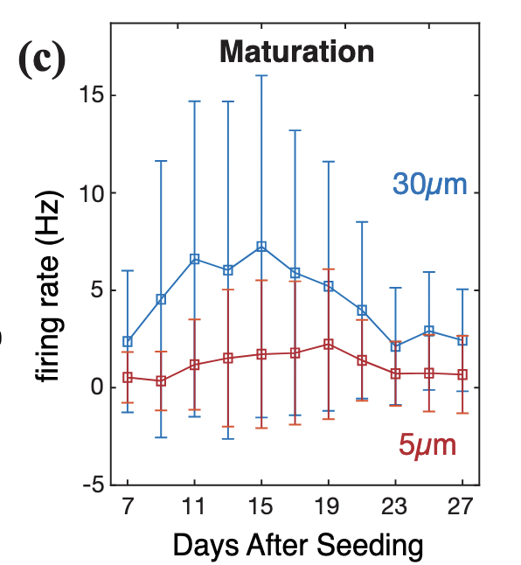
Neuronal Attachment to Micro Electrodes
Zhang, Xiaotian, Zhi Dou, Seung Hyun Kim, Gaurav Upadhyay, Daniel Havert, Sehong Kang, Kimia Kazemi, et al. 2024. “Mind In Vitro Platforms: Versatile, Scalable, Robust, and Open Solutions to Interfacing with Living Neurons.” Advanced Science 11 (11): 2306826. https://doi.org/10.1002/advs.202306826.

Slide 11
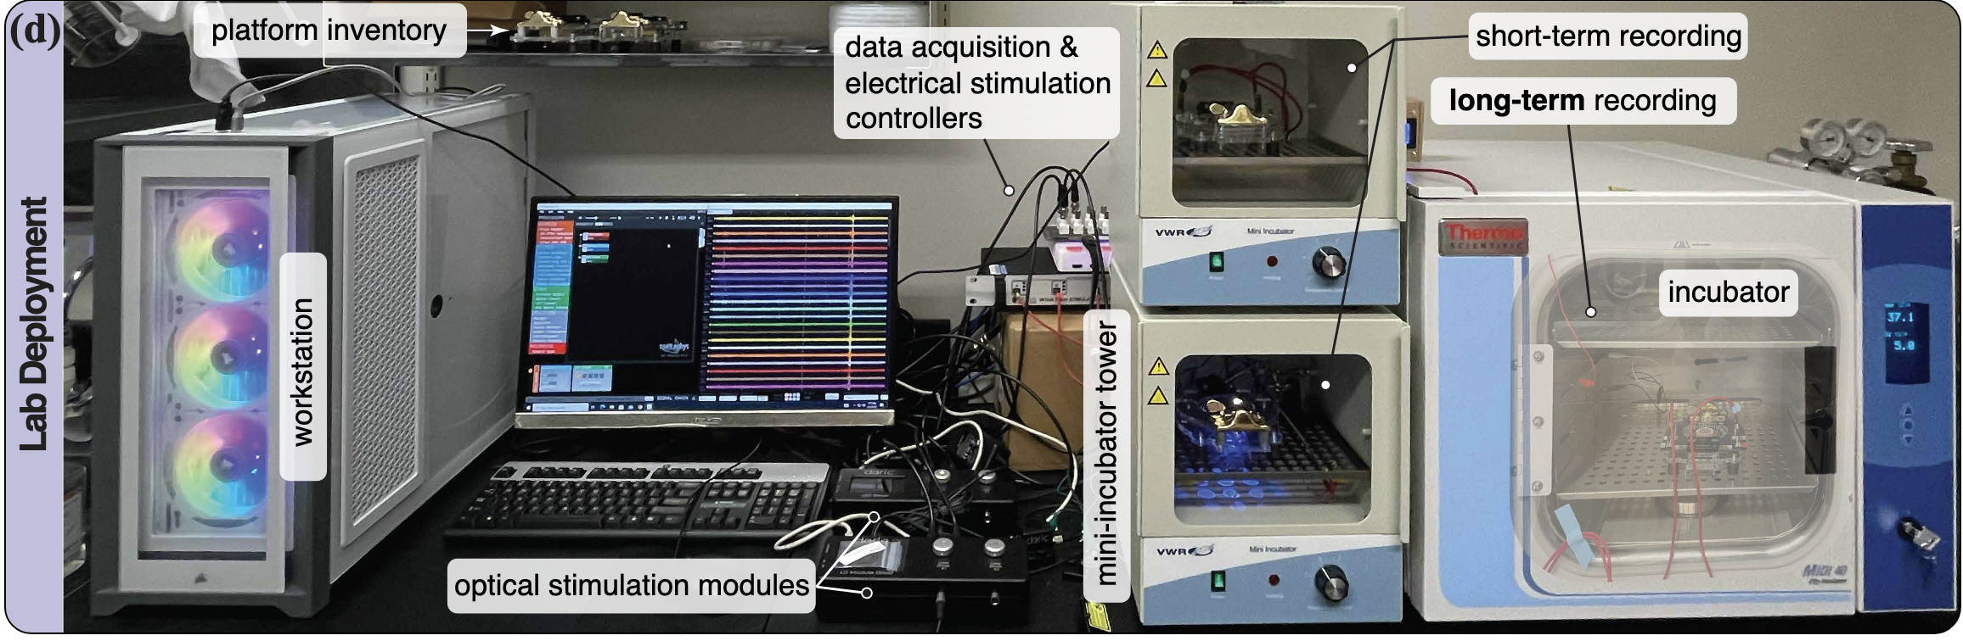
Incubator Unit
Zhang, Xiaotian, Zhi Dou, Seung Hyun Kim, Gaurav Upadhyay, Daniel Havert, Sehong Kang, Kimia Kazemi, et al. 2024. “Mind In Vitro Platforms: Versatile, Scalable, Robust, and Open Solutions to Interfacing with Living Neurons.” Advanced Science 11 (11): 2306826. https://doi.org/10.1002/advs.202306826.

Slide 12
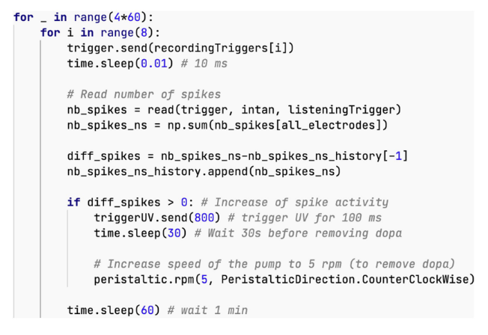
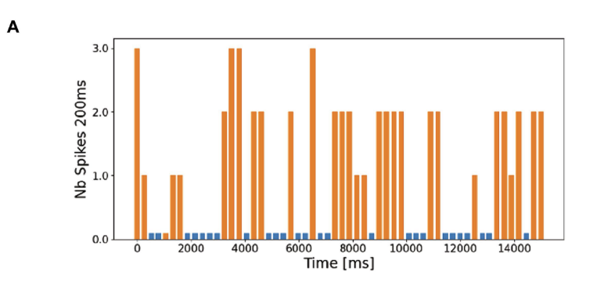
Code Execution
“The bar chart in Figure 7A displays a segment of the experimental results. It shows a 15-s recording from a single electrode, corresponding to one execution of step 4 in the pseudo code above… The orange bars in this plot are the result of the parameters selected in step 1 of the pseudo code.”
Jordan, Fred D., Martin Kutter, Jean-Marc Comby, Flora Brozzi, and Ewelina Kurtys. 2024. “Open and Remotely Accessible Neuroplatform for Research in Wetware Computing.” Frontiers in Artificial Intelligence 7 (May). https://doi.org/10.3389/frai.2024.1376042.

Slide 13
Conclusion(s)?
Questions to answer before markets get serious:
What’s the return on investment?
Current Unknowns: Cost per Organoid, Lifetime
2. What’s political/regulatory risk?
Current Unknowns: lmao
3. Is it 10x better than standard alternatives?
Current Unknowns:
How fast to retrain an organoid model?
How many models can one organoid learn?
What kind of mistakes/risk do organoid-intelligences entail?

Slide 14
Appendix: Lifetime of Organoids
“Initially, their lifetime was only a few hours, but various improvements, especially related to the microfluidics setup, have extended this to up to 100 days in best cases.” (Jordan et al., 2024, p. 14).
Jordan, Fred D., Martin Kutter, Jean-Marc Comby, Flora Brozzi, and Ewelina Kurtys. 2024. “Open and Remotely Accessible Neuroplatform for Research in Wetware Computing.” Frontiers in Artificial Intelligence 7 (May). https://doi.org/10.3389/frai.2024.1376042.

Slide 15
Appendix: Dopamine
“Carboxynitroveratryl (CNV)-caged dopamine (Tocris Bioscience) was dissolved in Neurobasal Plus at the concentration of 1 mM, and injected in the fluidic system.
After 3 h from the injection, the uncaging experiment started as described in paragraph 5.3. UV Silver-LED fiber-coupled LED (Prizmatix) was used to uncage the dopamine at the wavelength of 365 nm for 800 ms each time.”
Jordan, Fred D., Martin Kutter, Jean-Marc Comby, Flora Brozzi, and Ewelina Kurtys. 2024. “Open and Remotely Accessible Neuroplatform for Research in Wetware Computing.” Frontiers in Artificial Intelligence 7 (May). https://doi.org/10.3389/frai.2024.1376042.

Slide 16
Appendix: Facts on Efficiency
“Since June 2022, the USA’s Frontier has been the world’s most powerful supercomputer, reaching 1102 petaFlops (1.102 exaFlops) on the LINPACK benchmarks. The power consumption of the new supercomputer is 21 megawatts, while the human brain operates at the estimated same 1 exaFlop and consumes only 20 watts (Table 1) (8–11).
Thus, humans operate at a 10^-6 fold better power efficiency relative to modern machines albeit while performing quite different tasks.” (Smirnova et al., 2023, p. 3)
Smirnova, Lena, Brian S. Caffo, David H. Gracias, Qi Huang, Itzy E. Morales Pantoja, Bohao Tang, Donald J. Zack, et al. 2023. “Organoid Intelligence (OI): The New Frontier in Biocomputing and Intelligence-in-a-Dish.” Frontiers in Science 1 (February). https://doi.org/10.3389/fsci.2023.1017235.

Slide 17
Appendix: Organoid-on-Organoid Action
“A sensory organ, such as a retinal organoid, could then be connected with a brain organoid. Eventually, networks of organoids will be interconnected to implement more complex [Organoid Intelligence] (OI).
The organoid will be interfaced with electrical and fluidic-sensing and simple outputs controlling machines through biofeedback on the cellular level; i.e. giving the brain organoid control by feeding back the results of its induced actions.” (Smirnova et al., 2023, p. 13)
Smirnova, Lena, Brian S. Caffo, David H. Gracias, Qi Huang, Itzy E. Morales Pantoja, Bohao Tang, Donald J. Zack, et al. 2023. “Organoid Intelligence (OI): The New Frontier in Biocomputing and Intelligence-in-a-Dish.” Frontiers in Science 1 (February). https://doi.org/10.3389/fsci.2023.1017235.

Slide 18
Appendix: Ethical Dilemmas
“Could organoids experience pain and, if so, would they suffer – even in rudimentary ways? These concerns will mount during the development of OI, as the organoids become structurally more complex, receive inputs, generate outputs, and – at least theoretically – process information about their environment and build a primitive memory.” (Smirnova et al., 2023, p. 15)
Smirnova, Lena, Brian S. Caffo, David H. Gracias, Qi Huang, Itzy E. Morales Pantoja, Bohao Tang, Donald J. Zack, et al. 2023. “Organoid Intelligence (OI): The New Frontier in Biocomputing and Intelligence-in-a-Dish.” Frontiers in Science 1 (February). https://doi.org/10.3389/fsci.2023.1017235.

Slide 19
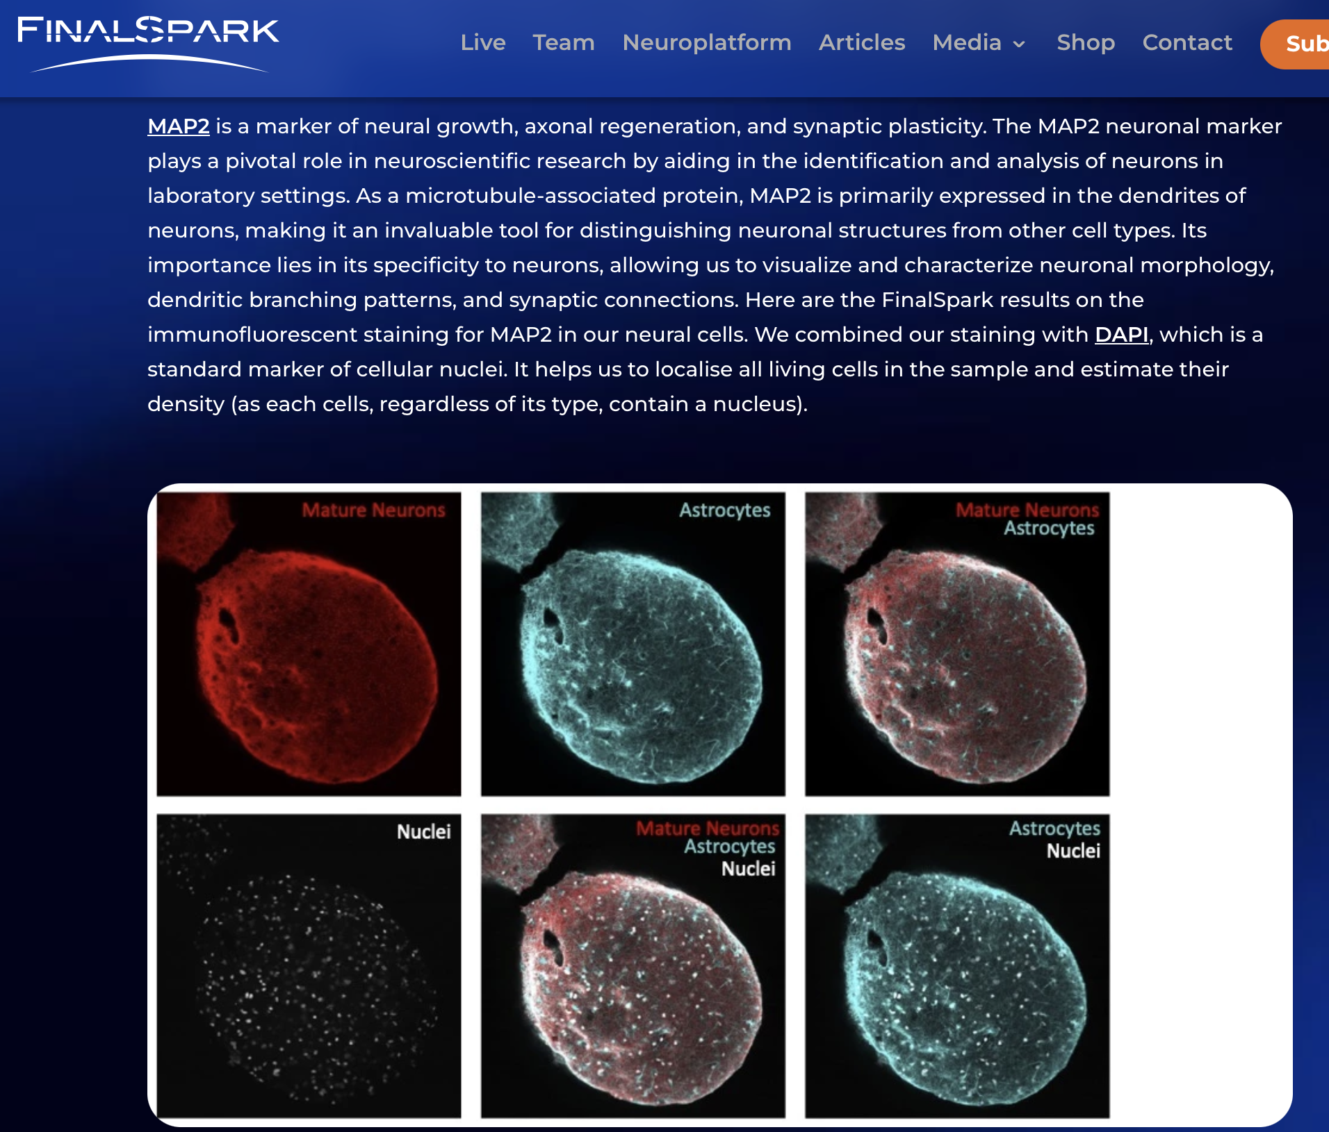
Appendix: Biomarkers
Kurtys, Ewelina. 2024. “How Do We Know We Have Real Neurons in Our Lab?” June 18, 2024. https://finalspark.com/how-do-we-know-we-have-real-neurons-in-our-lab/.

Slide 20
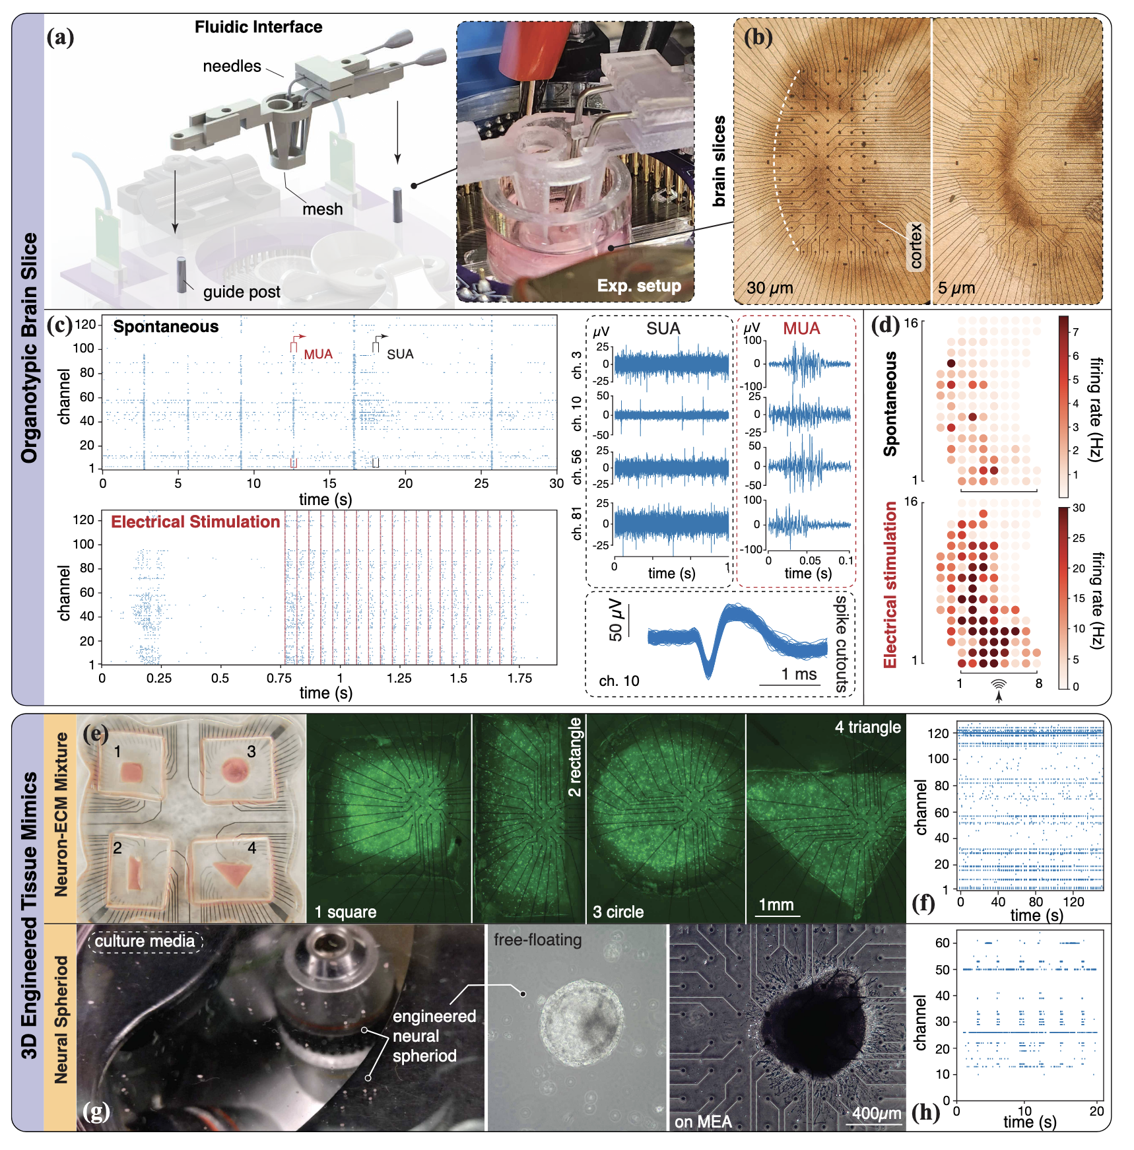
Appendix: Micro-Fluidics
Zhang, Xiaotian, Zhi Dou, Seung Hyun Kim, Gaurav Upadhyay, Daniel Havert, Sehong Kang, Kimia Kazemi, et al. 2024. “Mind In Vitro Platforms: Versatile, Scalable, Robust, and Open Solutions to Interfacing with Living Neurons.” Advanced Science 11 (11): 2306826. https://doi.org/10.1002/advs.202306826.

Slide 21
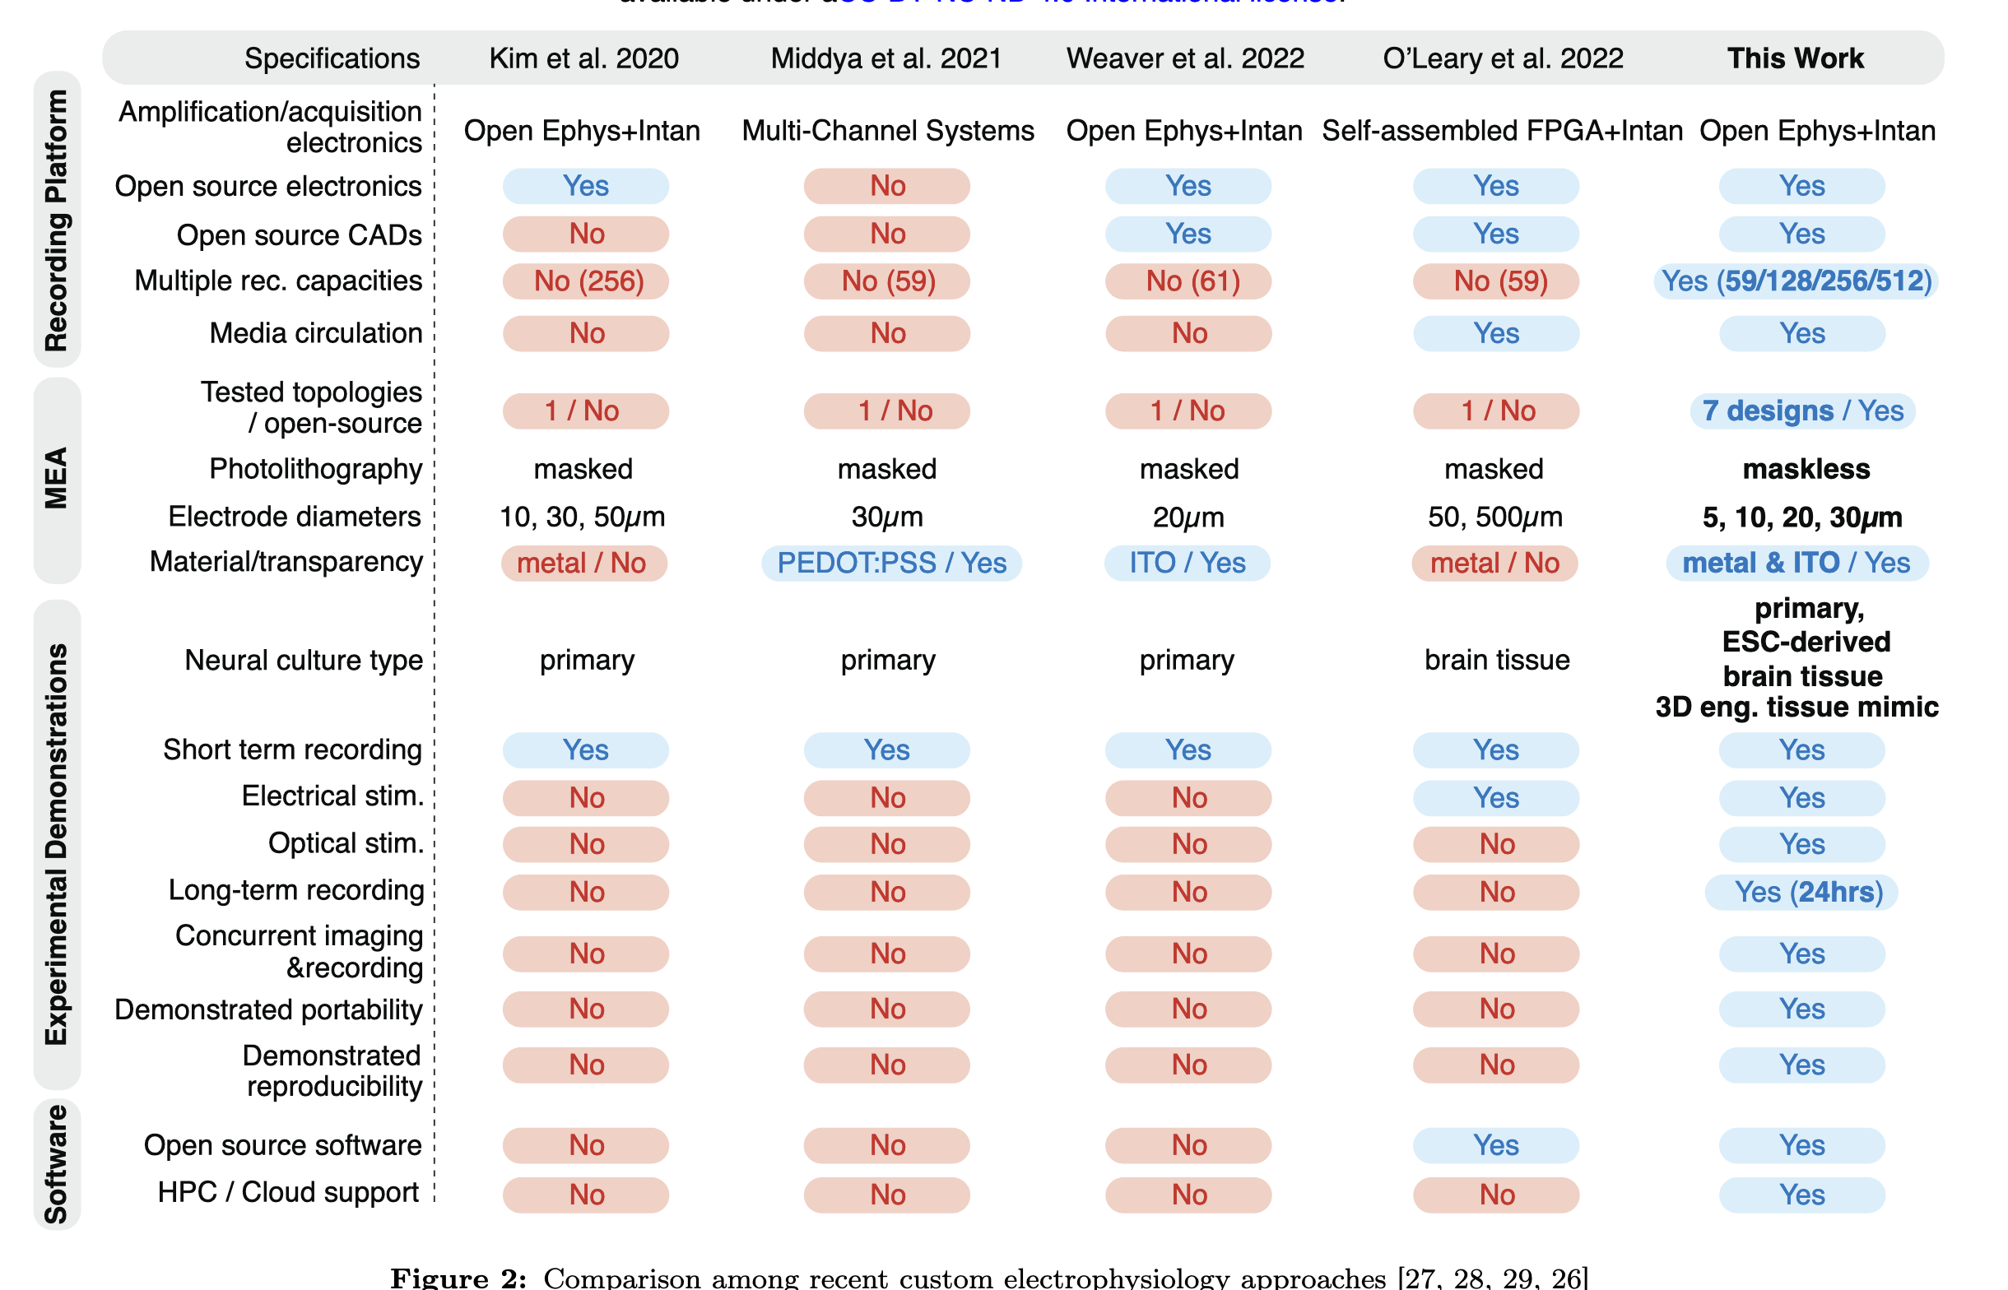
Appendix: Research
Zhang, Xiaotian, Zhi Dou, Seung Hyun Kim, Gaurav Upadhyay, Daniel Havert, Sehong Kang, Kimia Kazemi, et al. 2024. “Mind In Vitro Platforms: Versatile, Scalable, Robust, and Open Solutions to Interfacing with Living Neurons.” Advanced Science 11 (11): 2306826. https://doi.org/10.1002/advs.202306826.

